Slide 1
Environmental Guidance in Digital Games: Influencing Player Navigation Without Explicit Instruction
Morgan Hodge
MA Game Design
Research Question:
Which environmental design techniques are most effective at influencing player navigation and decision making without explicit guidance systems?
Project Overview:
Prototype 1 - Lighting
Existing Guidance Techniques
Research
Research Question
Prototype 2 - Architecture
User testing
Analysis & Findings
Prototype 3 - Landmarks

Slide 2
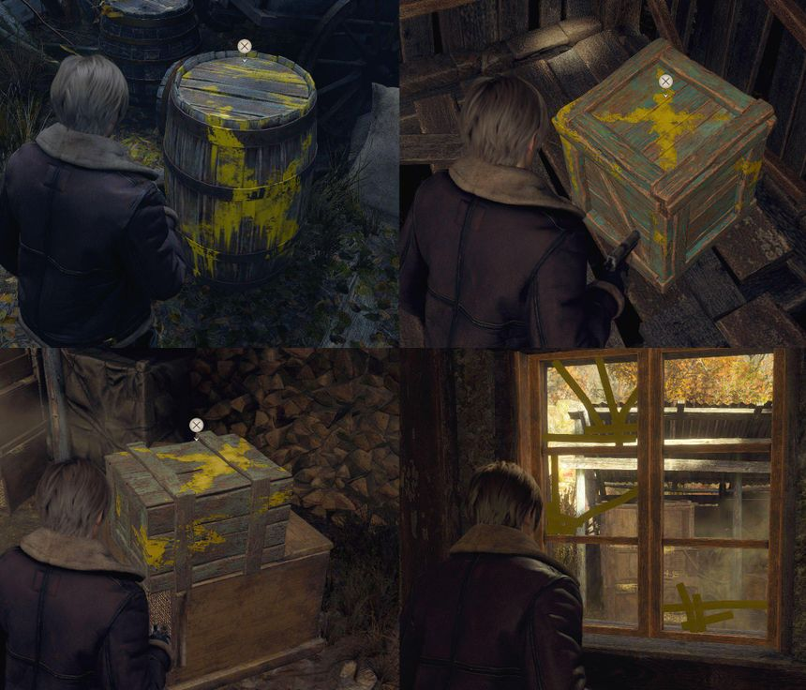
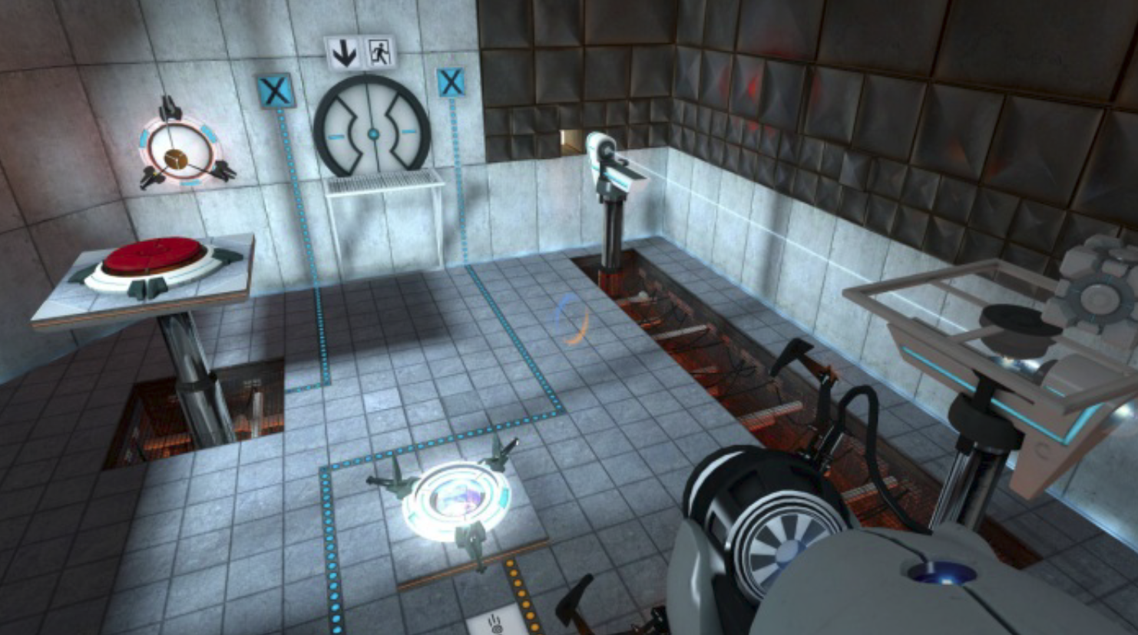
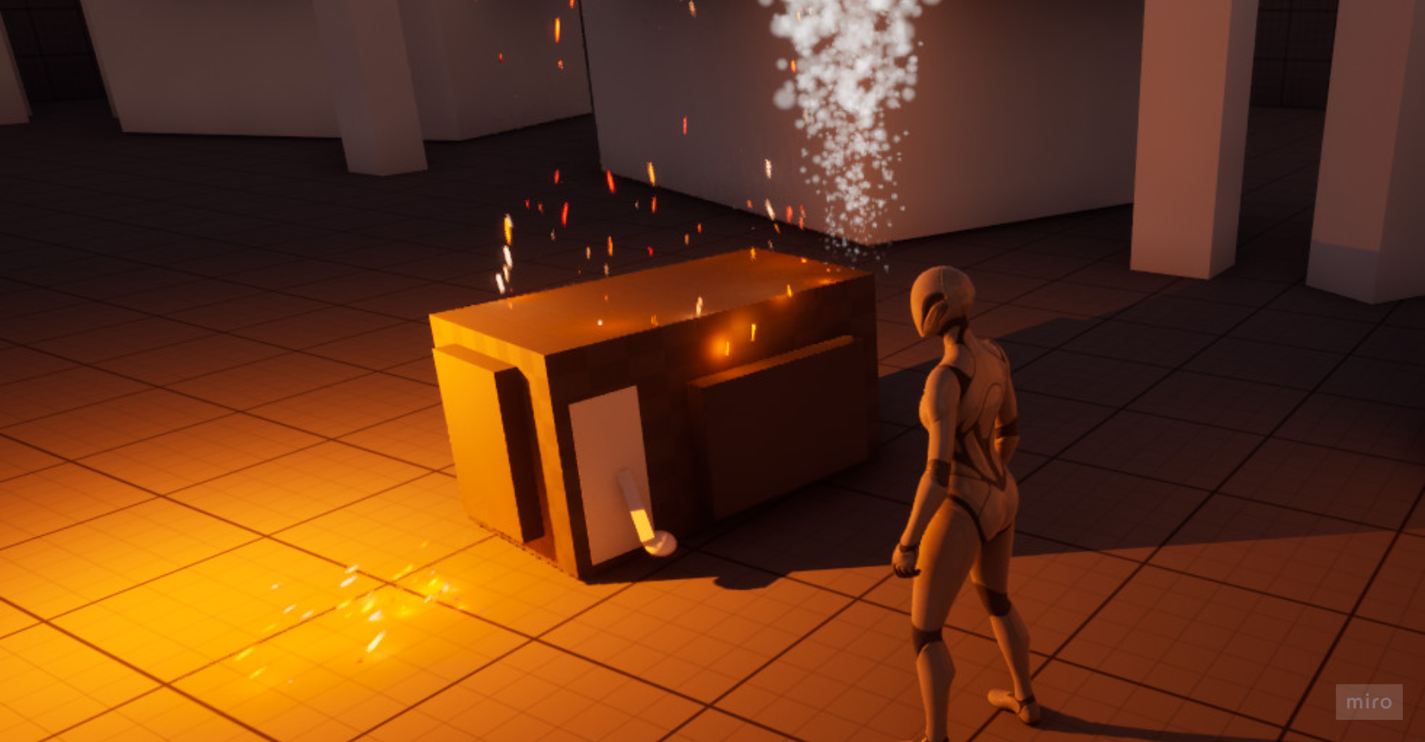
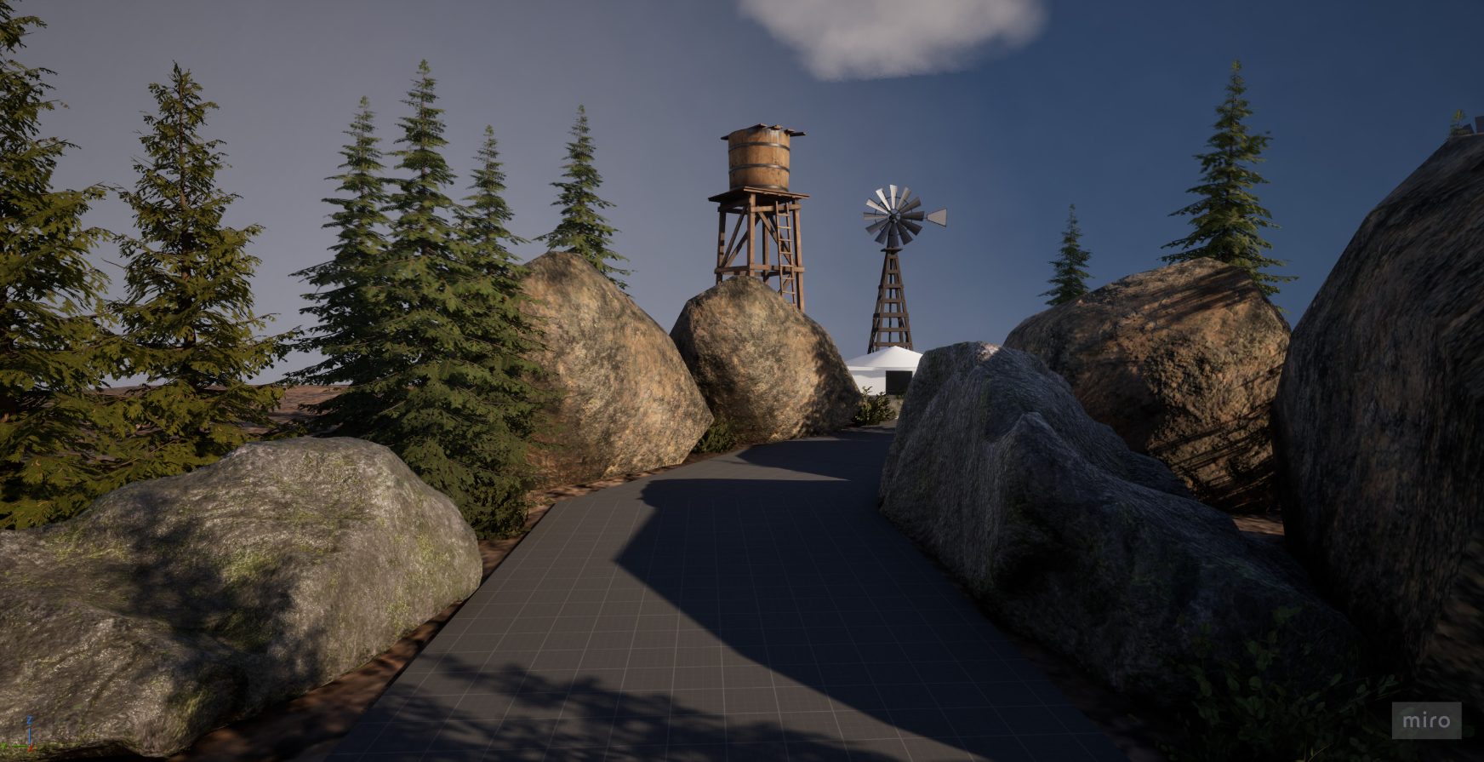
Context
Player Navigation is a fundamental part of level design
Players are constantly making decisions about where to go, what to investigate and which route to take
Many games support this through explicit systems such as:
Objective markers
Waypoints
Arrows
Mini Maps
However, these systems can reduce the need for the players to interpret the environment themselves
This project explores whether environmental design can communicate direction and influence player decision without relying on explicit guidance
Explicit Guidance
Environmental Guidance

Slide 3
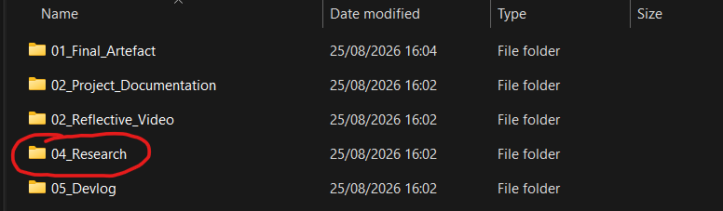
Research and Development Approach
Research
Literature & Contextual research
Analysis
Existing games + Guidance techniques
Development
Three Unreal Engine 5 Prototypes
Testing
Player testing & observation
Iteration
Analysis -> design changes -> retesting

Slide 4
Prototype 1: Lighting
What I investigated – Can lighting influence player direction and attract attention towards the intended route
What I built – Video Walkthrough
How it guides the player:
Contrast between light and dark areas
Brightness draws attention
Lighting creates a visual priority
Player is encouraged to investigate the illuminated area
What I learned
Lighting successfully attracted player attention, but its effectiveness was affected by the number and clarity of alternative routes

Slide 5
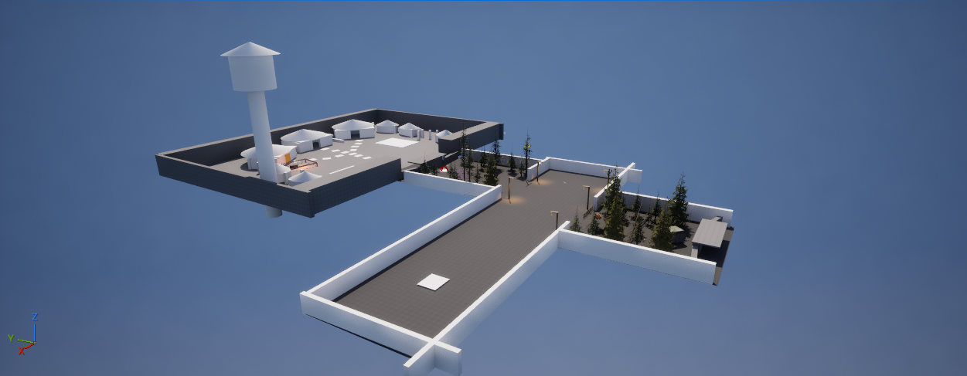
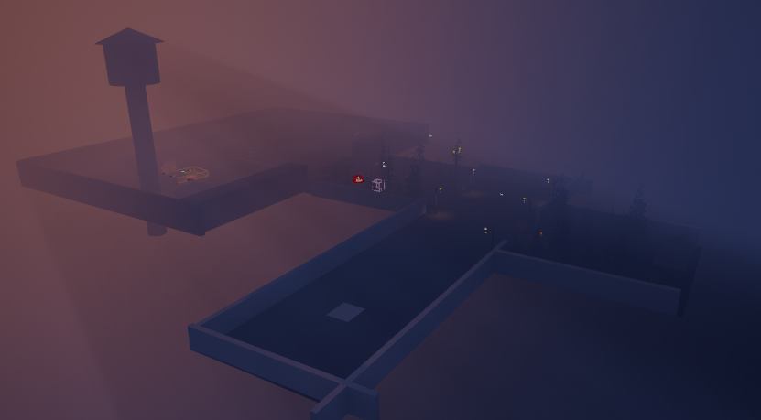
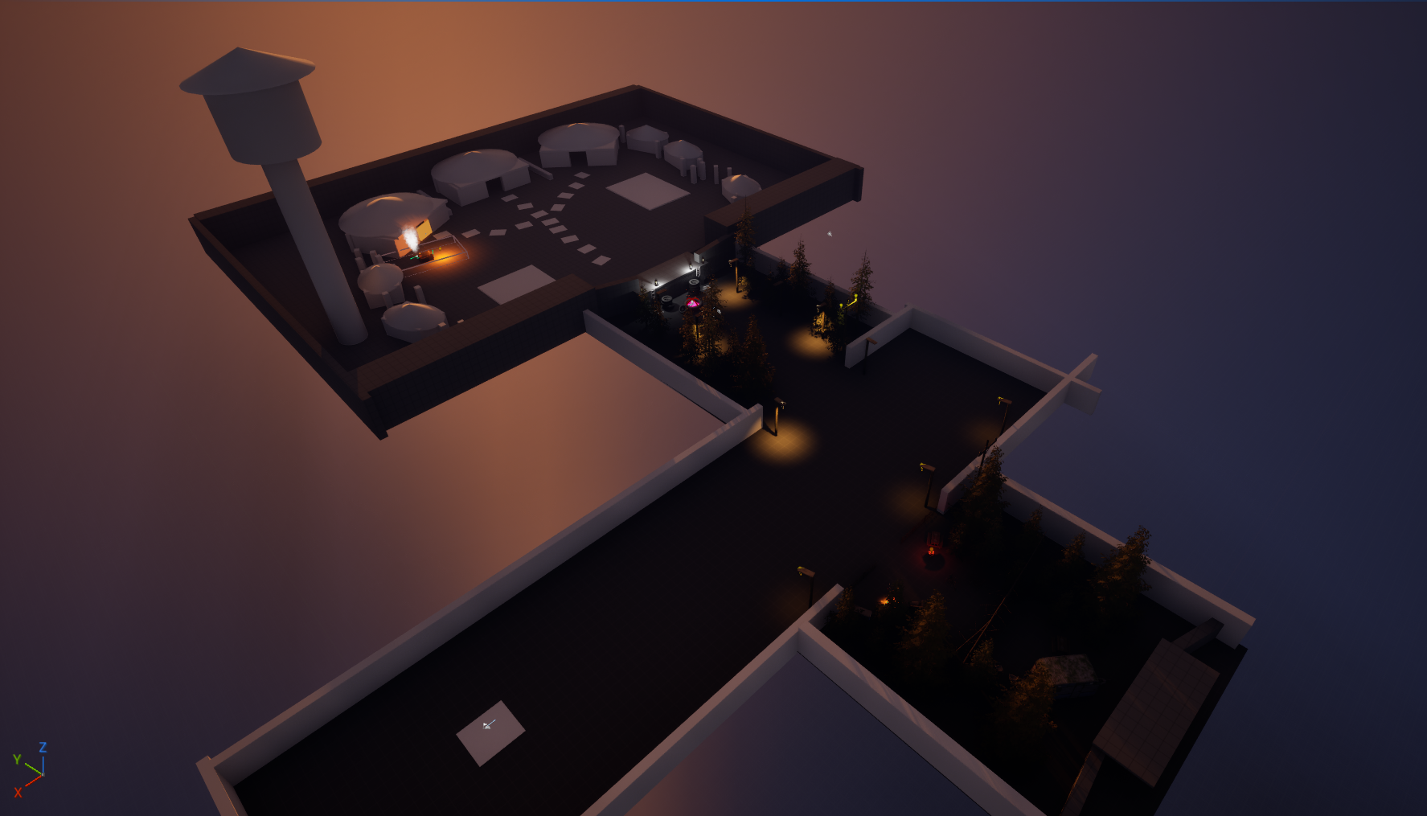

Slide 6
Prototype 2 – Architectural guidance
Can the Structure and layout of an environment influence which route a player chooses?
Approach:
Path width – making one route feel more significant
Framing – drawing attention towards areas of interest
Visibility & Reveals – Controlling what the player can see
Finding:
Architectural design successfully influenced route choice without explicitly telling players where to go
However, architectural cues can become strong enough to function as an obvious path

Slide 7
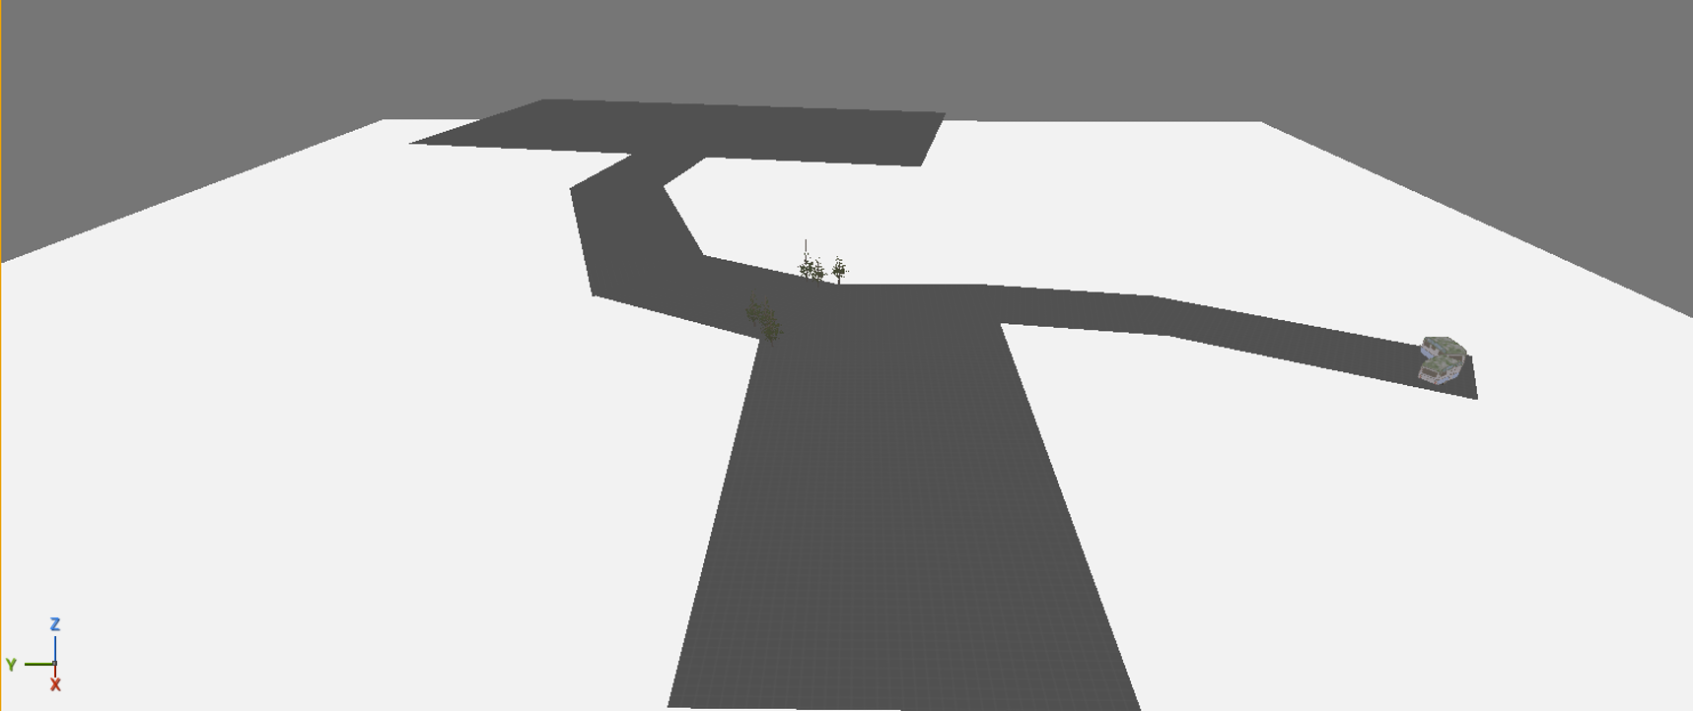
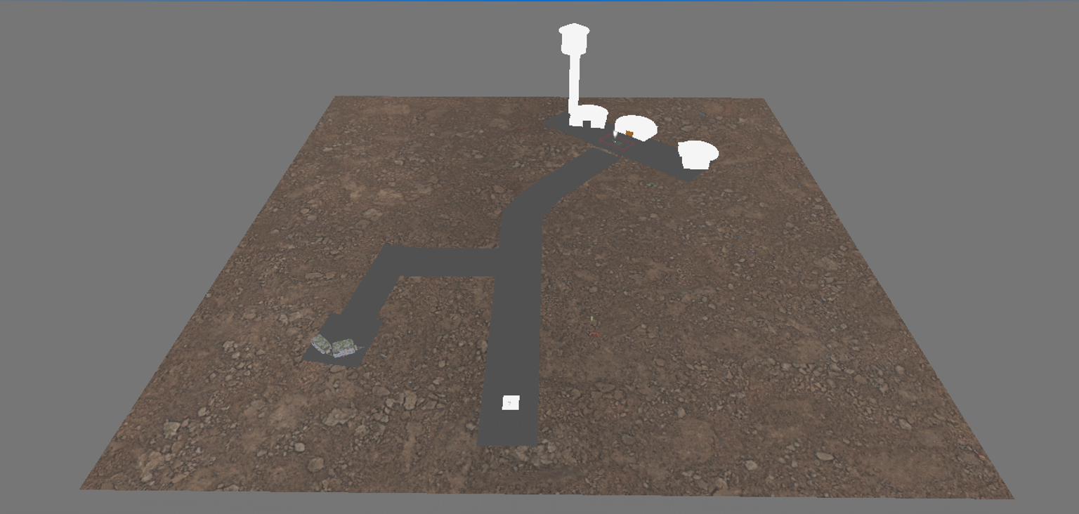
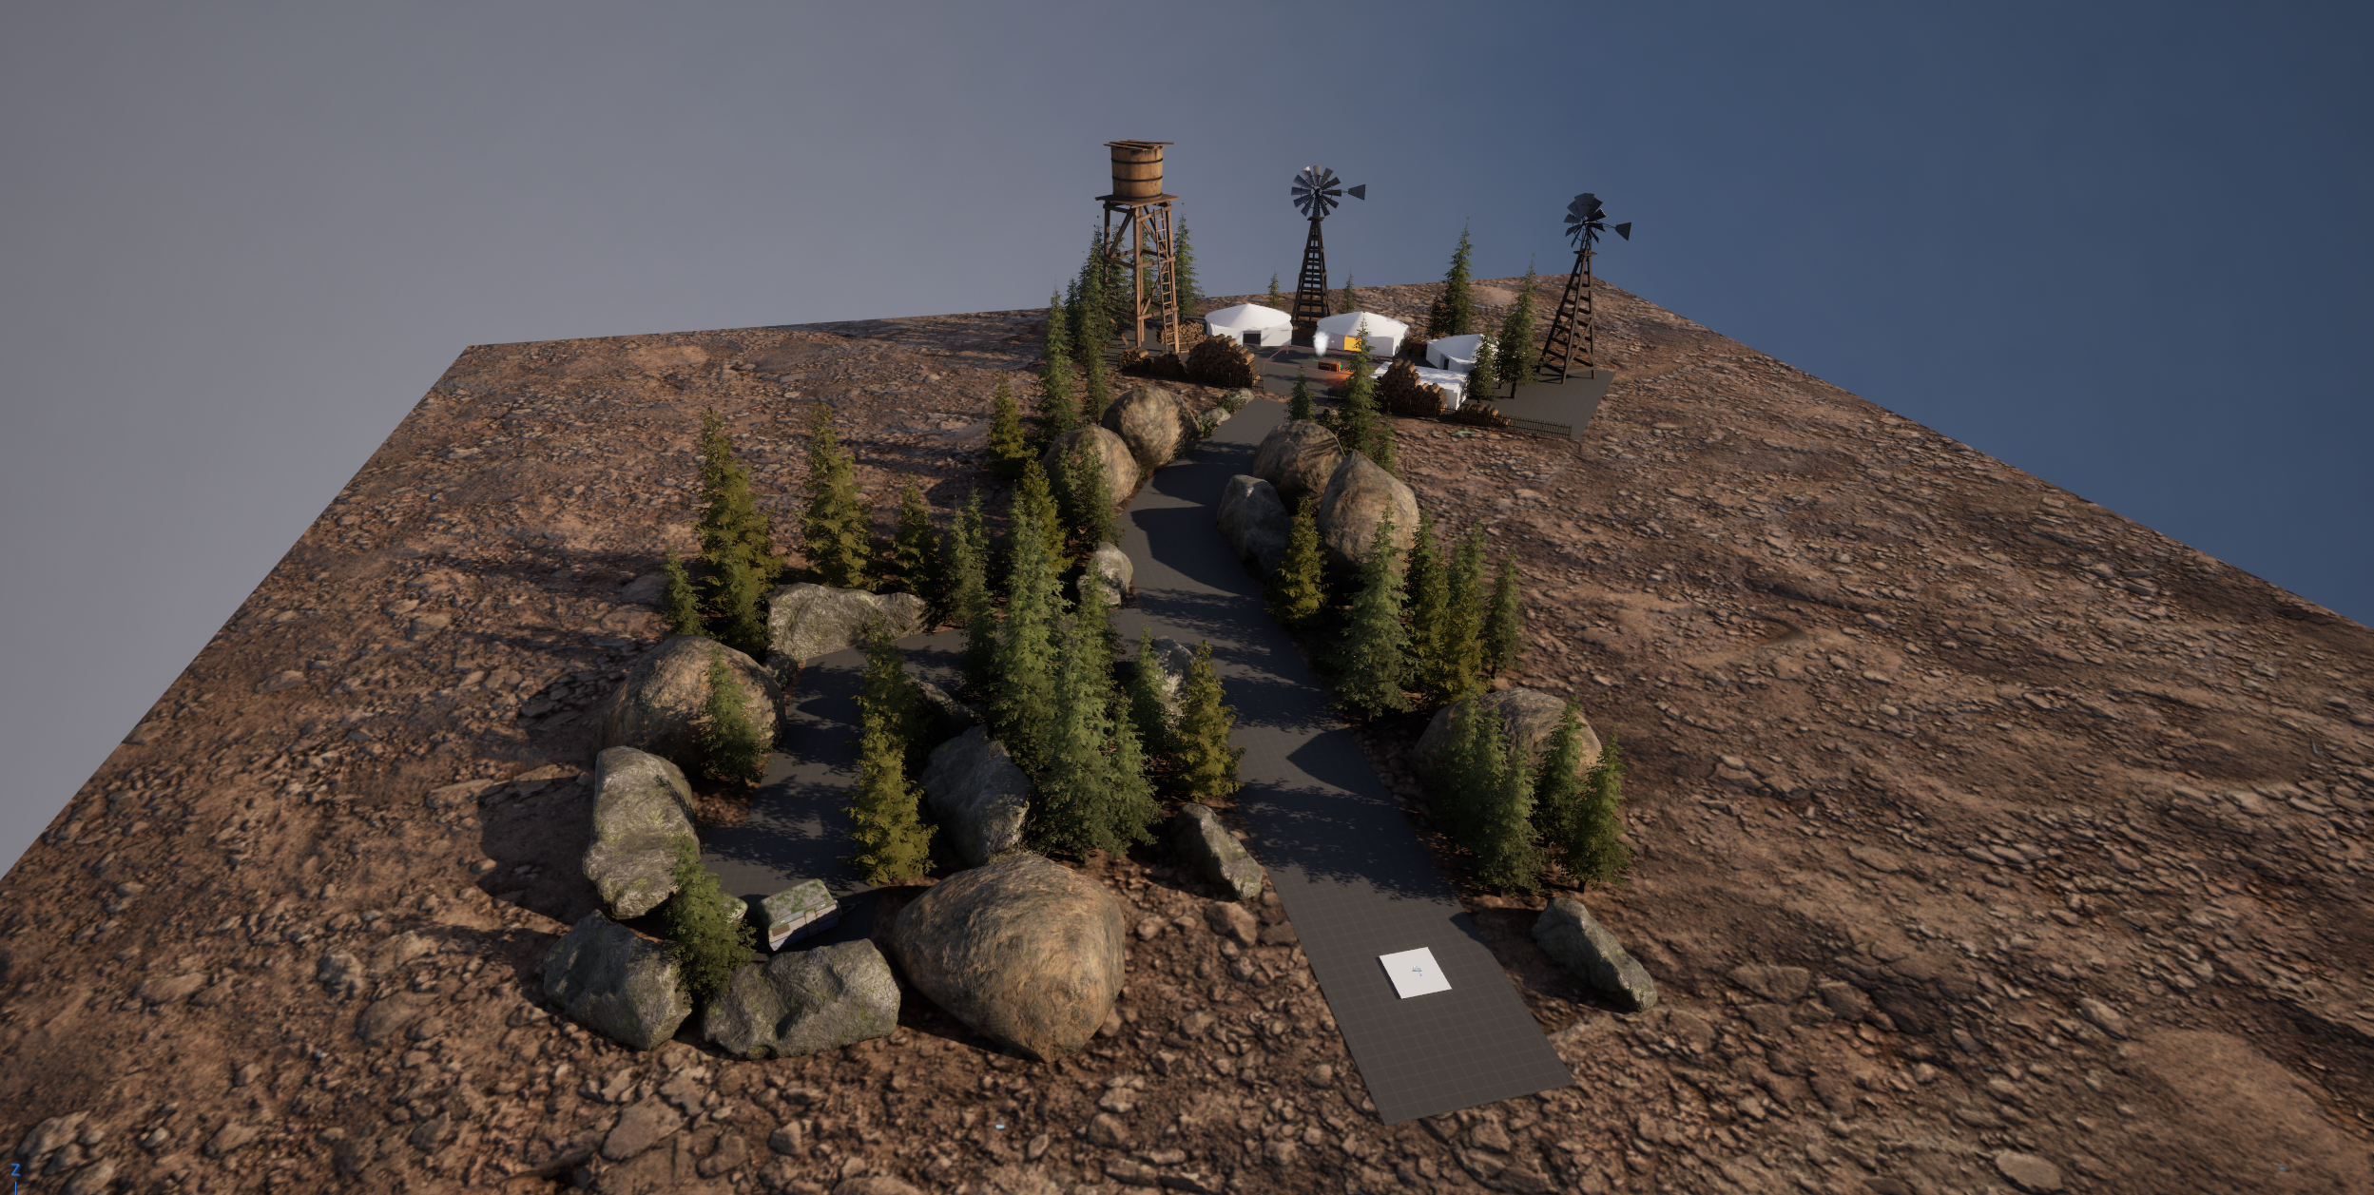

Slide 8
Prototype 3 - Landmarks
Can distinctive environmental landmarks help players navigate and maintain orientation without defined routes?
Initial Approach:
Large, recognisable landmarks
Water tower as visual reference
Players could use the landmark to understand direction and position
What I discovered from testing was the initial environment still contained strong architectural guidance
Iteration after testing:
Redesigned entire environment
Open terrain
Reduced routes
Added more environmental landmarks (Rivers, hills)
Retested
As a result, players were able to now use the water tower as a reference point for orientation

Slide 9
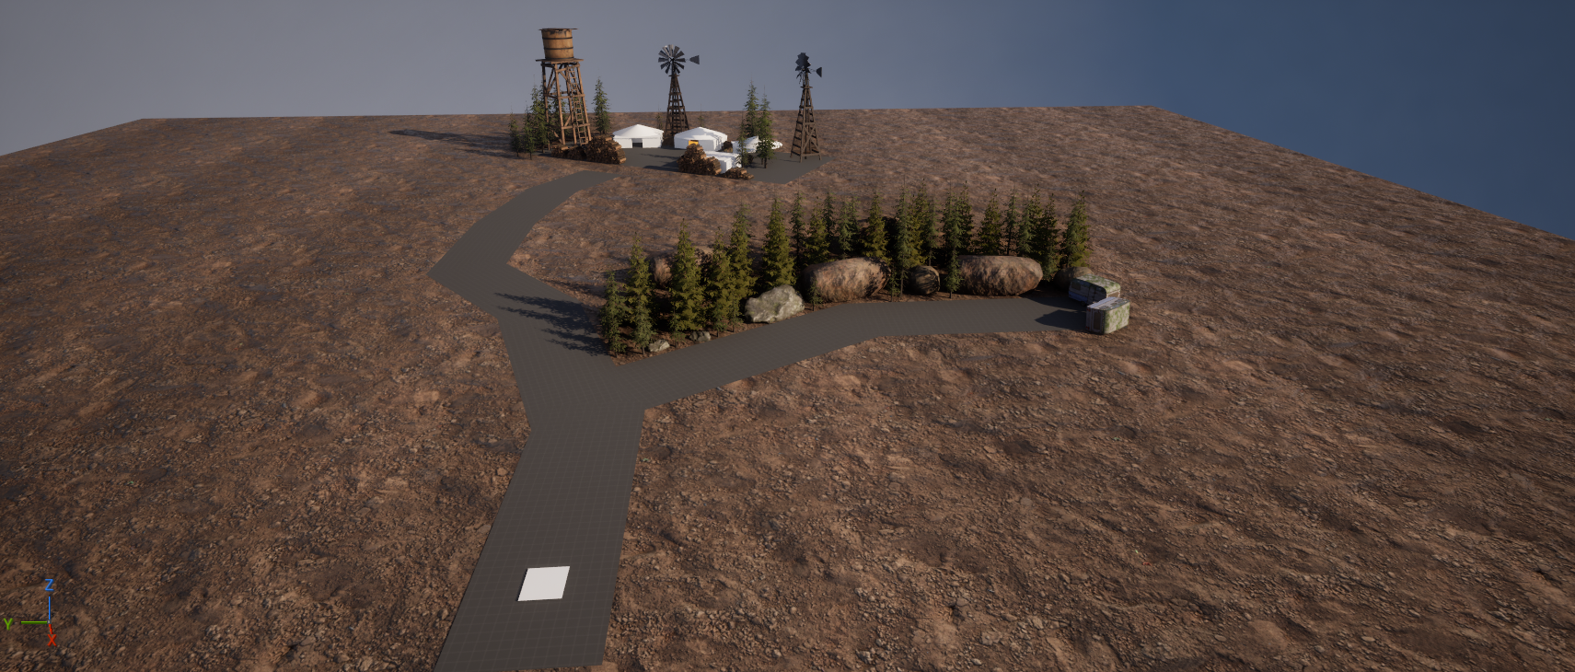
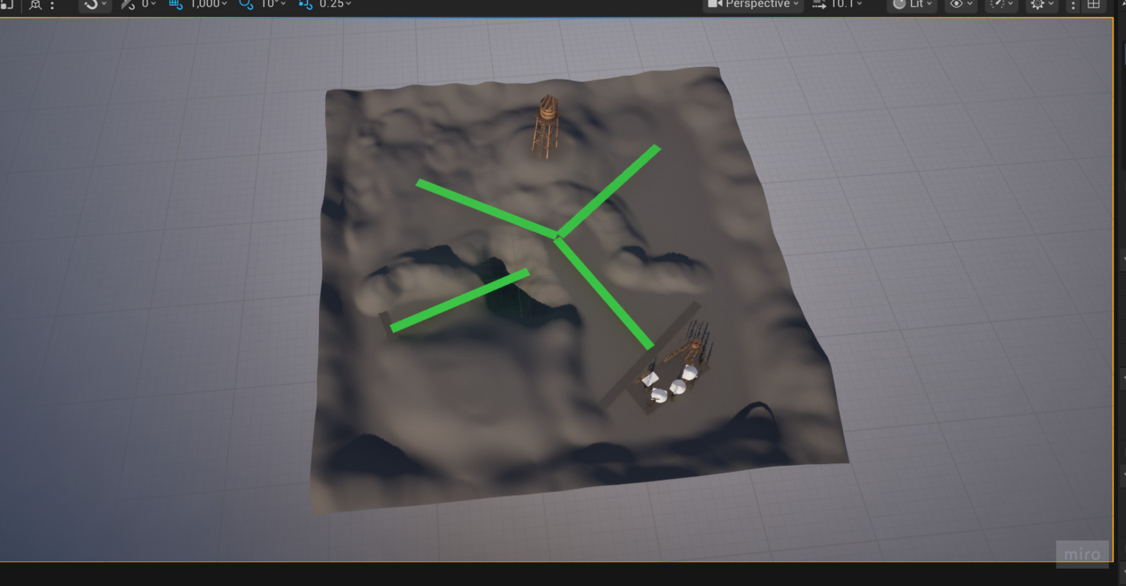
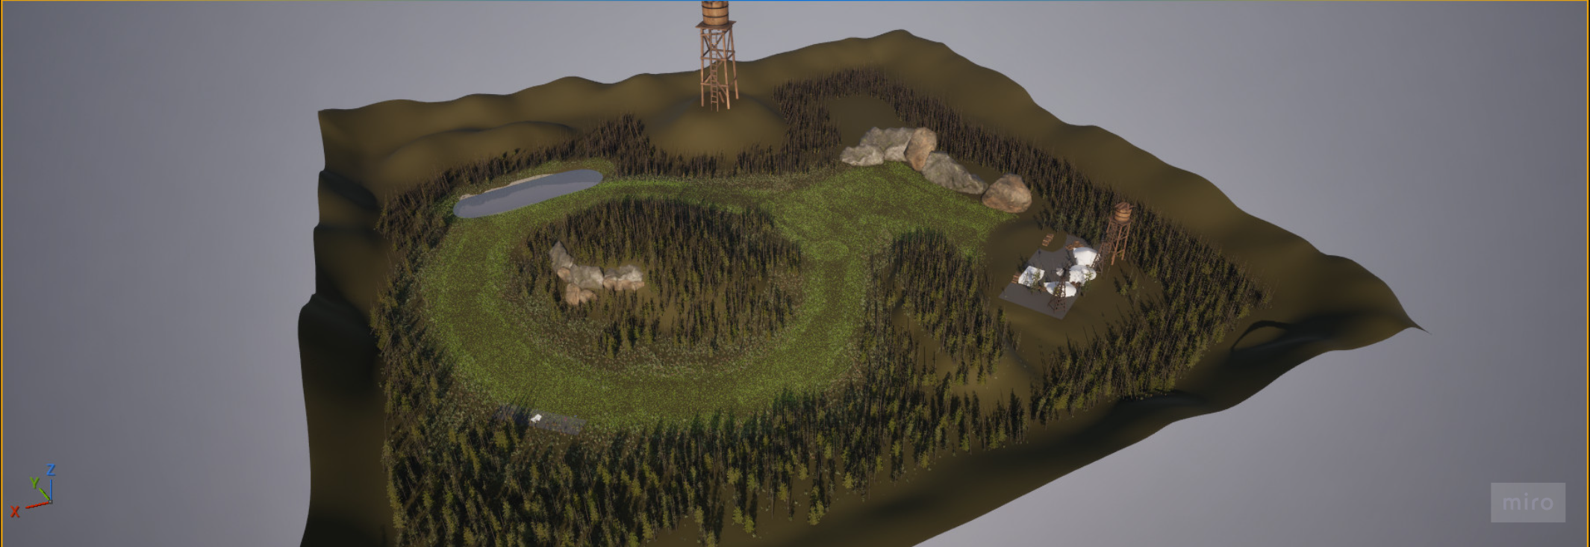

Slide 10
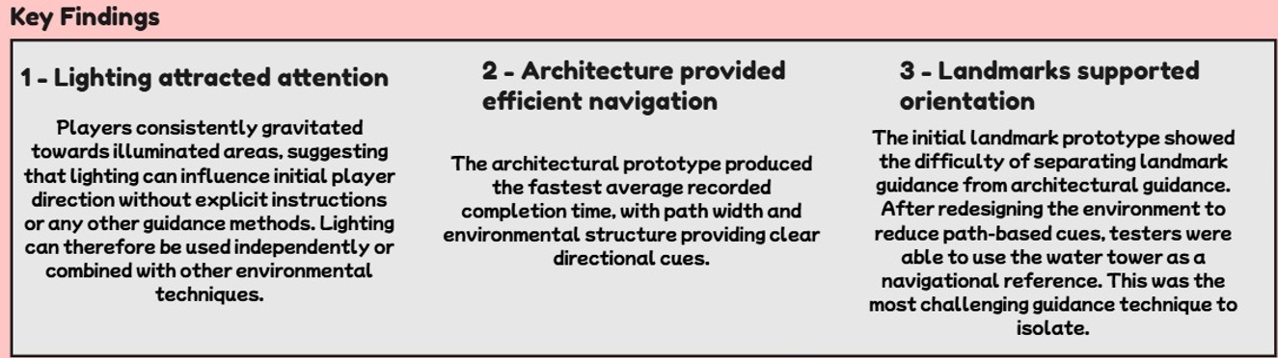
Testing and Findings
testers played the prototypes and were asked to navigate to the objective without explicit directional instructions
What was measured:
Objective completion
Completion time
Navigation confidence
Wrong turns/hesitation
Player Feedback
Recorded Results
Key Findings
Lighting – Successfully attracted player attention
Architecture – Strongest and most direct route influence
Landmarks – Initially difficult to isolate, but became more effective after removing competing routes
The environment influenced navigation, but competing environmental cues could change how players interpreted the intended guidance

Slide 11
Research Findings
Lighting
Visual contrast and lighting can attract attention and influence where players look and move
Architecture
Spatial configuration, paths, openness and enclose can influence how players interpret possible routes
Landmarks
Distinctive environmental features can provide reference points that help players orient themselves and build an understanding of the space
Effective environmental guidance should communicate direction without explicitly telling the player where to go

Slide 12
Audience and Value
For Level Design:
Demonstrates how environmental elements can communicate direction without explicit navigation UI
For Design Practice:
Shows the importance of controlling competing environmental cues when testing guidance techniques
For My Personal Practice: Developed my ability to
Prototype level design ideas
Learn Guidance techniques
Analyse player behaviour
Iterate from evidence
Work with Unreal Engine

Slide 13
Reflection and Future work
With More Time I would
Increase the amount of play testers
Test combinations – investigate how lighting, architecture and landmarks work together
Expand navigation scenarios – test different environments, routes and objectives
Get Insights from industry professionals – Reach out to veteran designers for their opinions and feedback on the matter
The project showed me that effective player guidance is not simply about adding cues – it's about designing the entire environment around how those cues are interpreted

Slide 14
Thank You For Watching
Trello Board – https://trello.com/invite/b/6a8dbf73cd13ddd812e5e8ea/ATTI0c9e0e22041a4d7c73544a4dde8c6507347EF6A7/gam706
GitHub Repository –
https://github.com/Mdot5596/MA-Dissertation
Portfolio Website – morganhodge.co.uk

